Slide 1



Paolo Delrio
Chirurgia Oncologica Colorettale
I.N.T. – «Fondazione G. Pascale» - IRCCS - Napoli
CME, CVL, D3: standard of care or surgical fashion?

Slide 2

what do we surgeons talk about….
HOW MUCH I DO IT
  sometimes
  always
  when it is needed
  when it happens!!!
CME = SEX
HOW I DO IT
  Down to up
  Up to down
  Between the legs!!!!

Slide 3
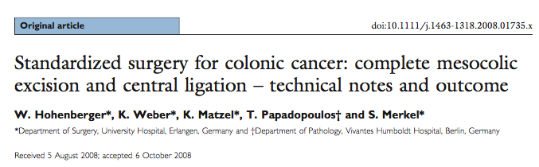
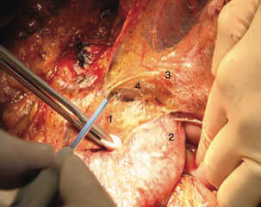
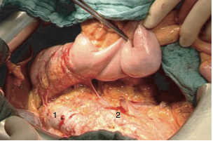
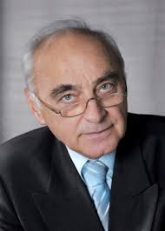
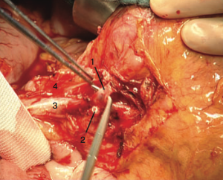
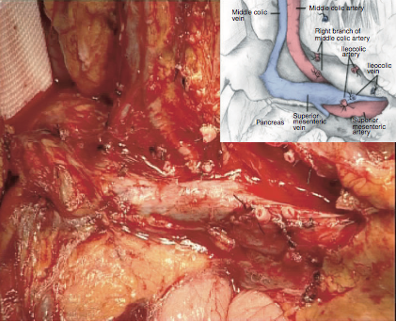
when it all started….
BACKGROUND
Colon CME = Rectum TME
Mesocolic fascia – mesorectal fascia
Surgery along embryological planes
Central vascular ligation (apical LN)
Wide excision of tumour bearing colon segment along the embryological planes within complete mesenteric envelope (mesenteric LN)
Notes:
Wide excision of tumour bearing colon
segment along the embryological planes
within complete mesenteric envelope (mesenteric LN)
• Central vascular ligation (apical LN)
• Resection of an adequate length of bowel
(5-10cm, pericolic LN)

Slide 4
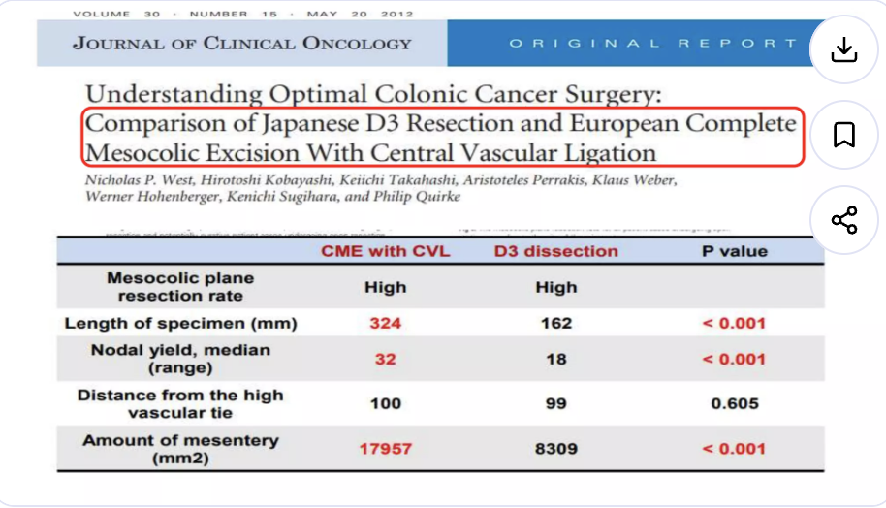

Slide 5
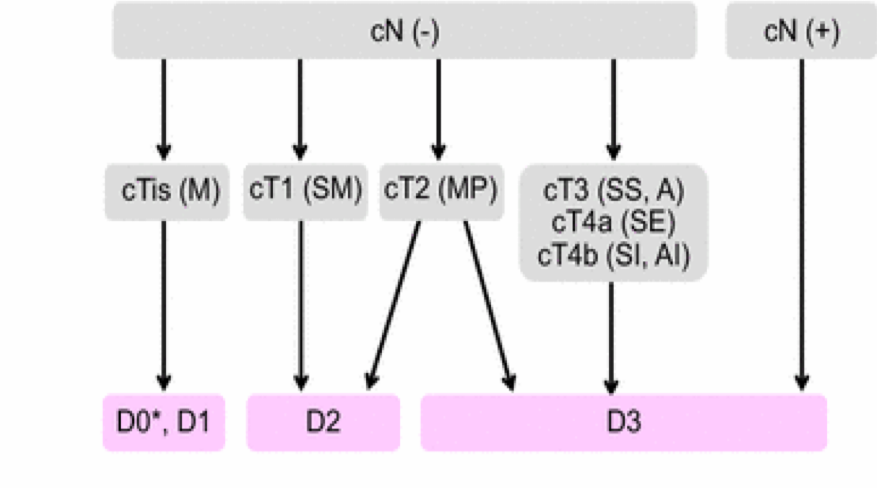
CME vs D3 Lymphadenectomy
- D3: Common in Japanese surgery
- CME: Emphasizes fascial plane dissection
- Both aim at central lymph node removal
JSCCR GUIDELINES FOR COLORECTAL CANCER RESECTION
since the 80’s

Slide 6
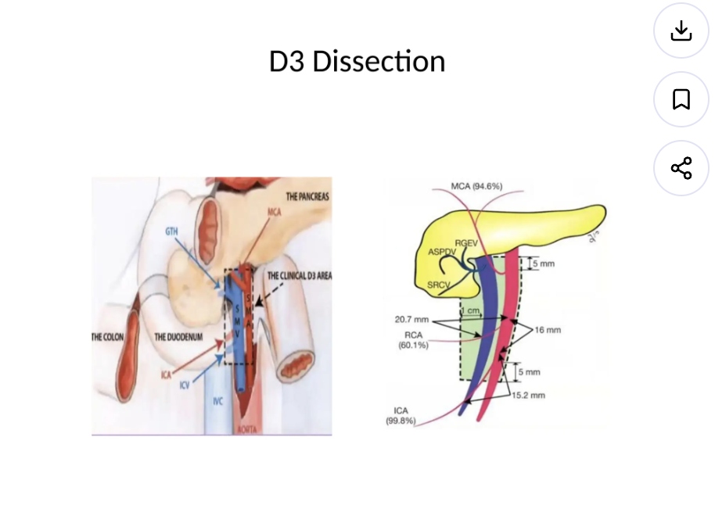
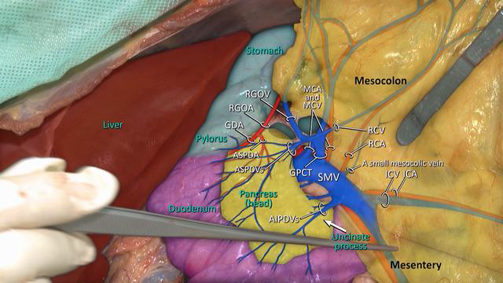
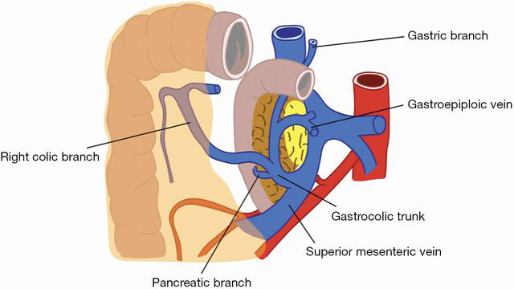
ANATOMICAL NOTES
D3 lymphadenectomy anatomical borders
(I) cranially—5 mm proximal to the horizontal line through the Henle trunk and middle colic artery origins
(II) caudally—5 mm distal to the horizontal line through the origin of the ileocolic artery
(III) medially—the left edge of the SMA
(IV) laterally—10 mm from the right edge of the SMV

Slide 7
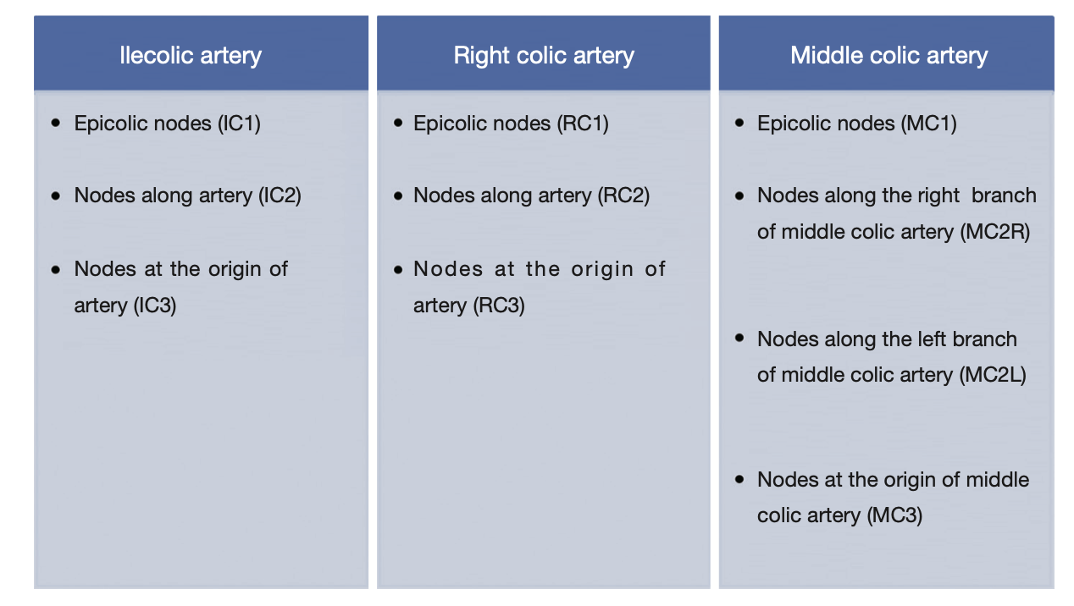
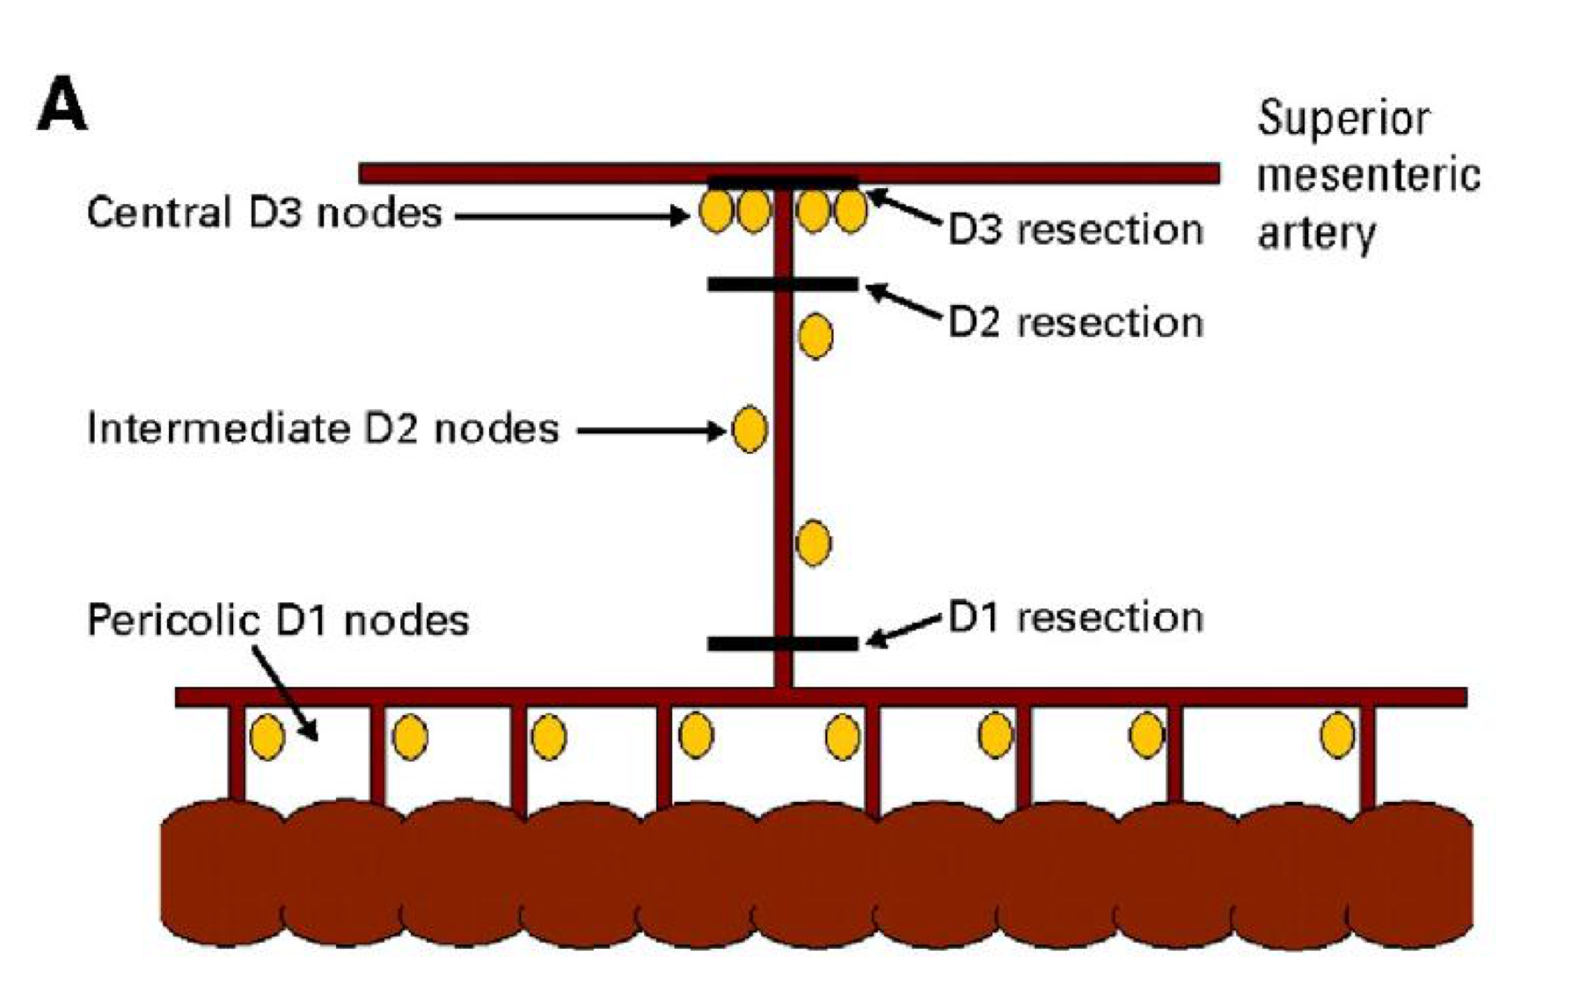
DEFINITION OF D3
  • Along the feeding vessel(s)
  • Pericolic, marginal artery D1
  • Mesenteric,intermediate nodes D2
  • Central, main nodes D3

Slide 8
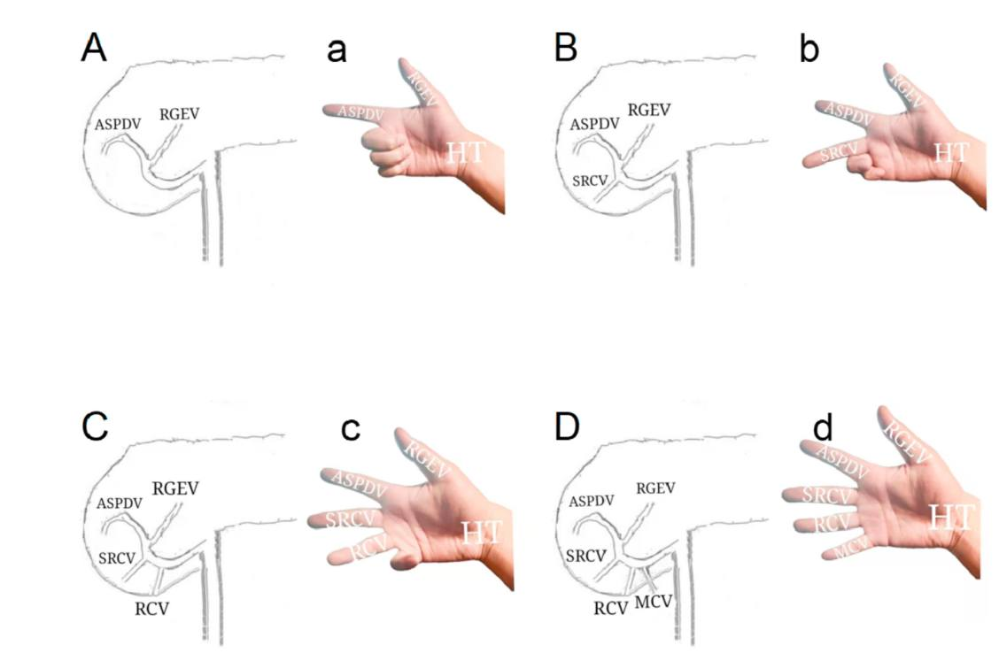

Slide 9
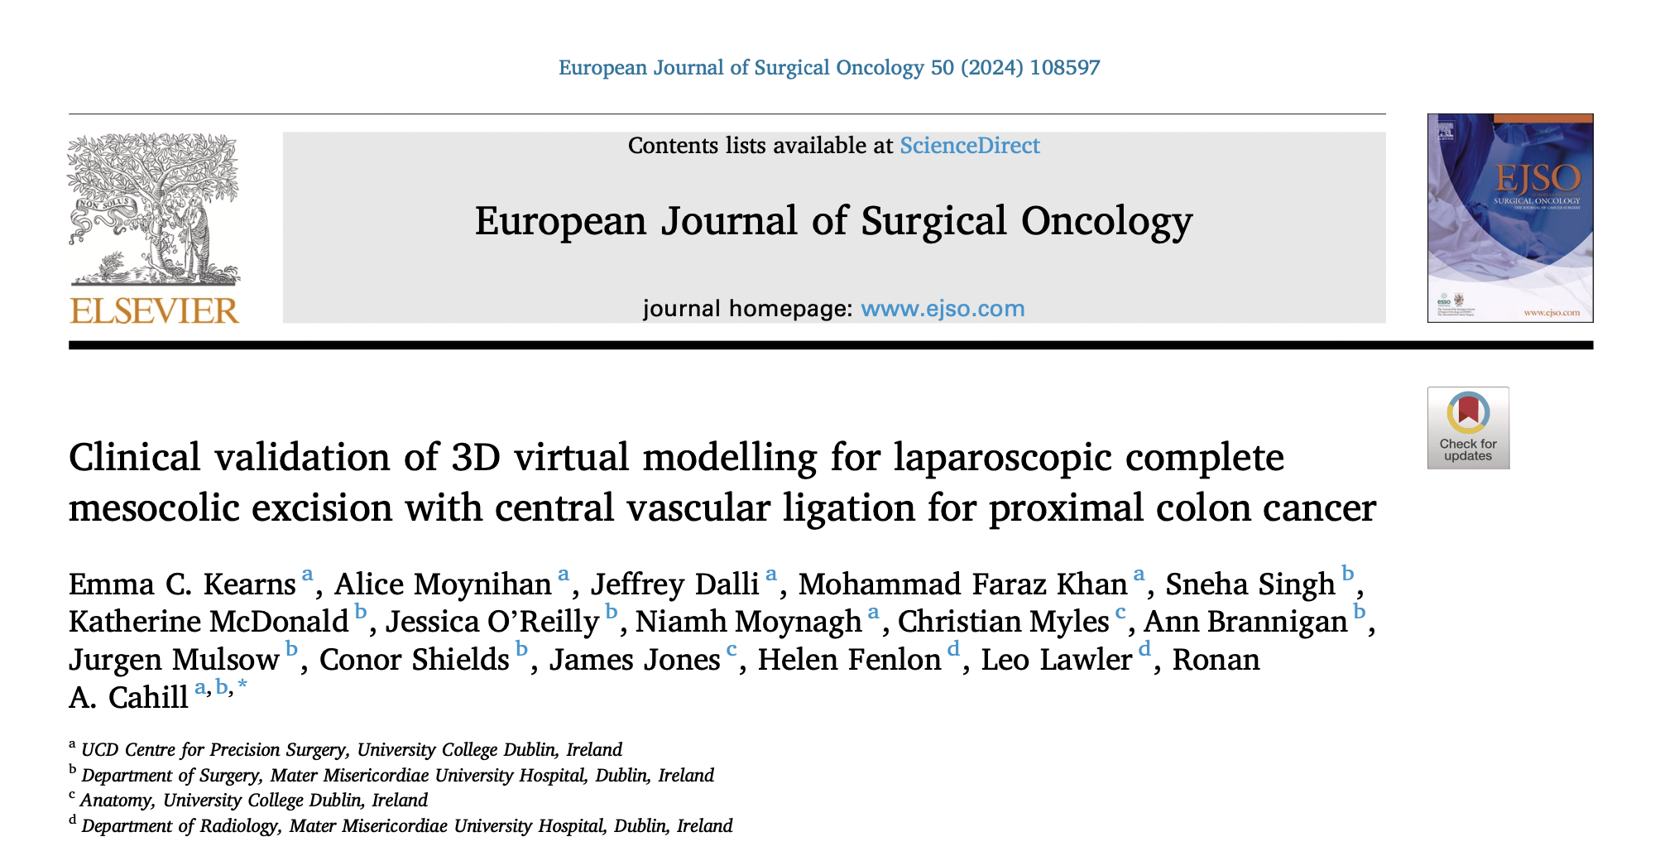
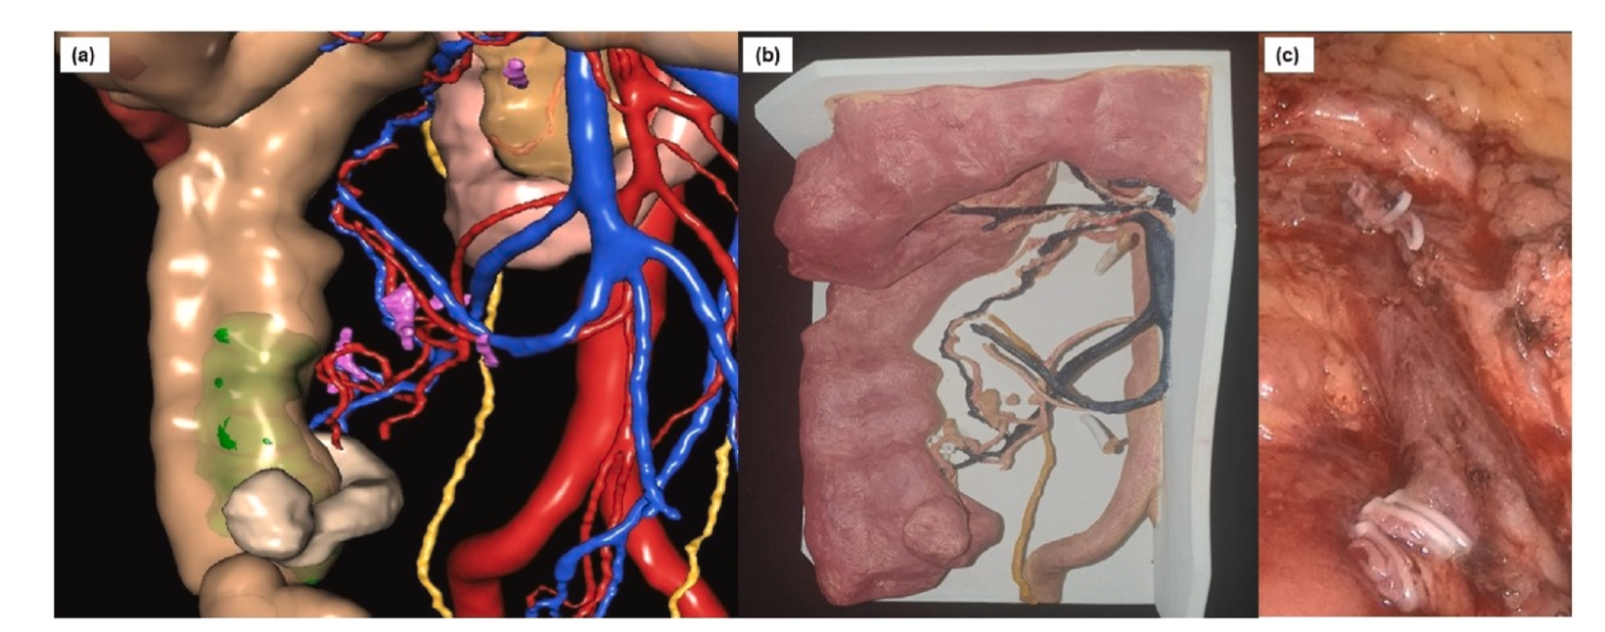

Slide 10
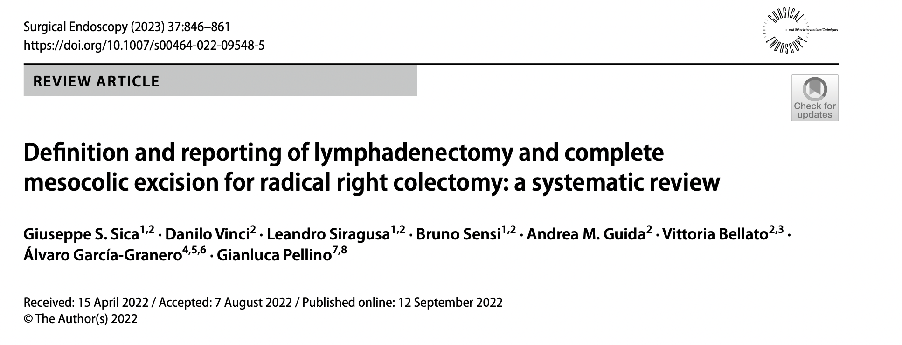
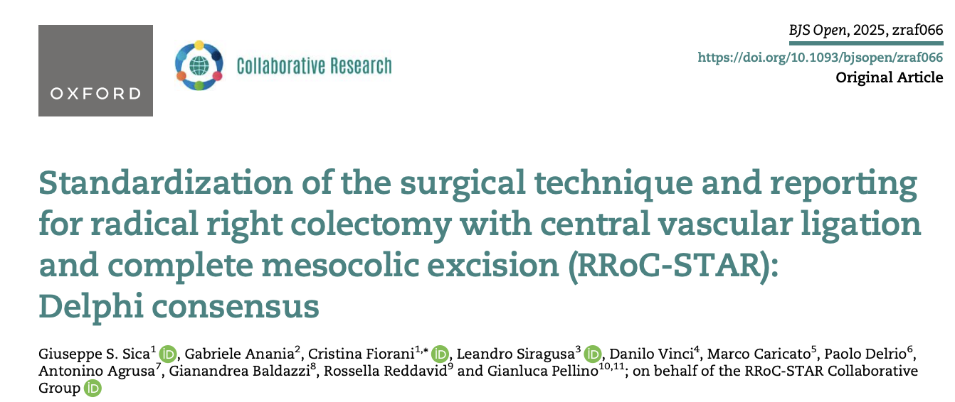
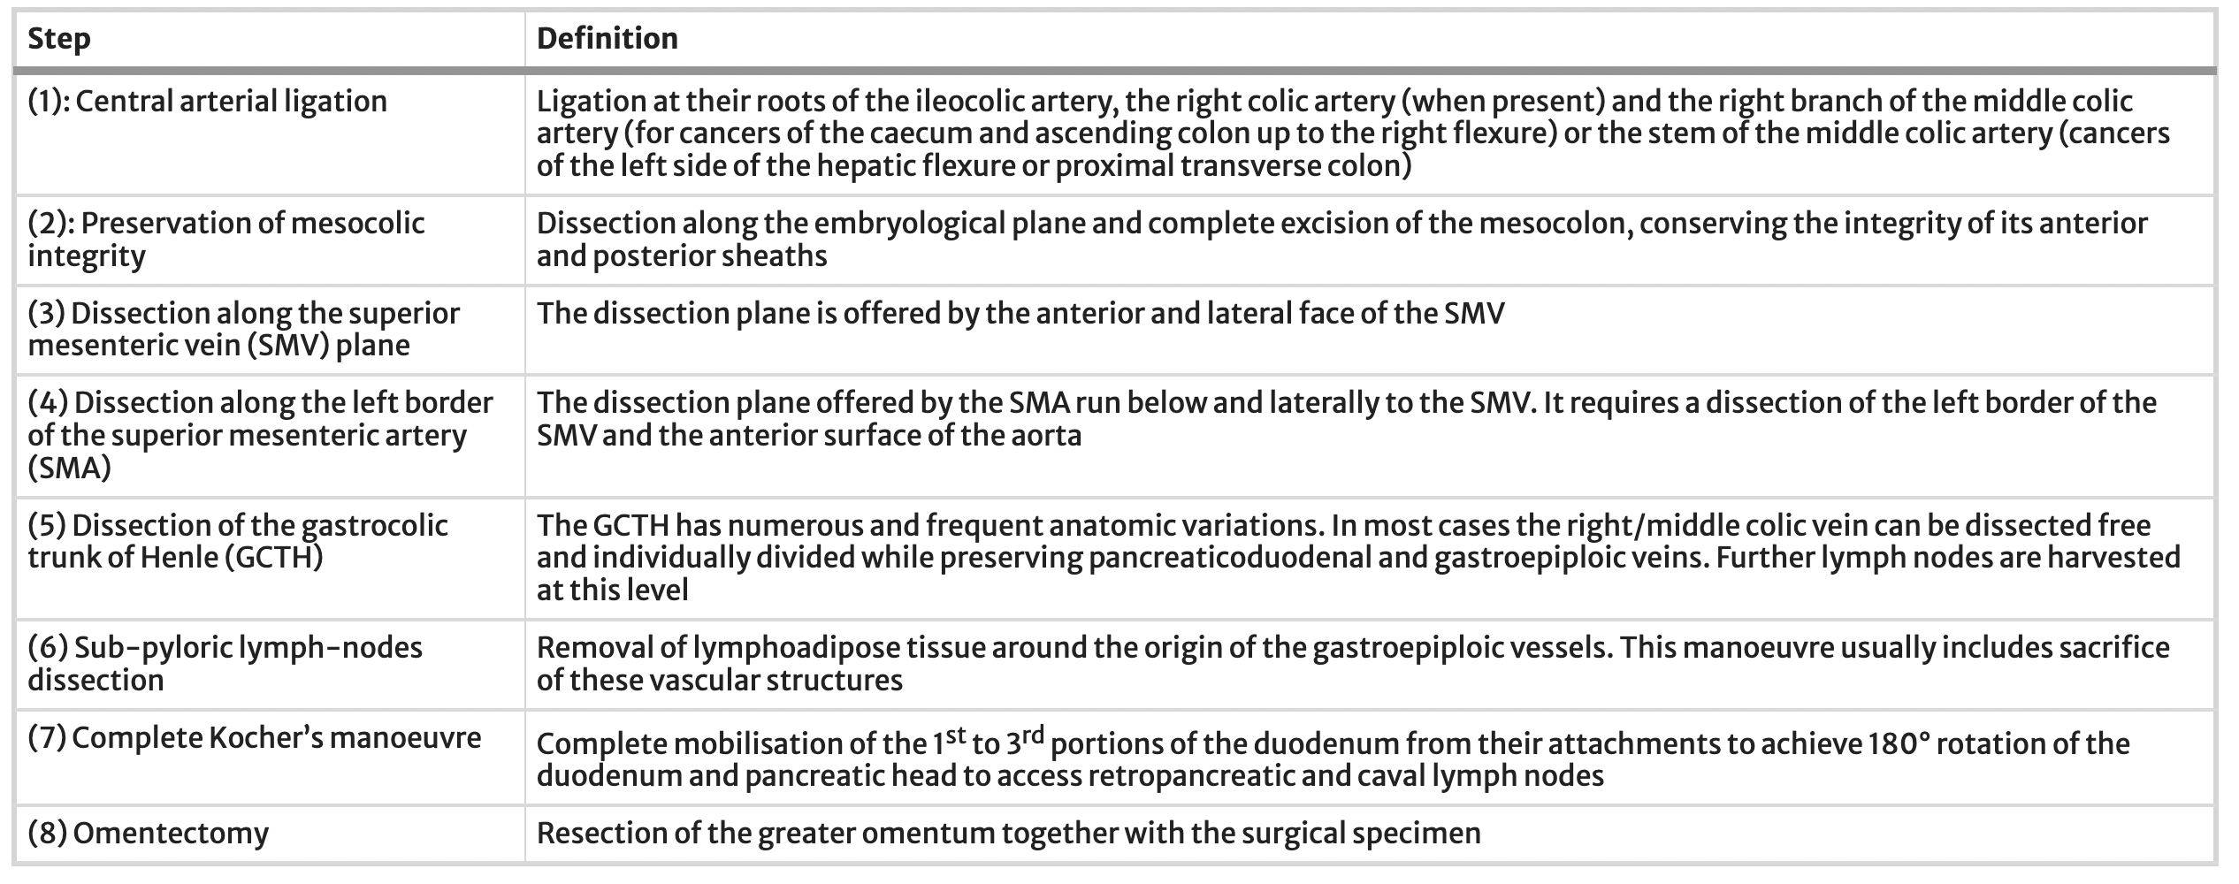
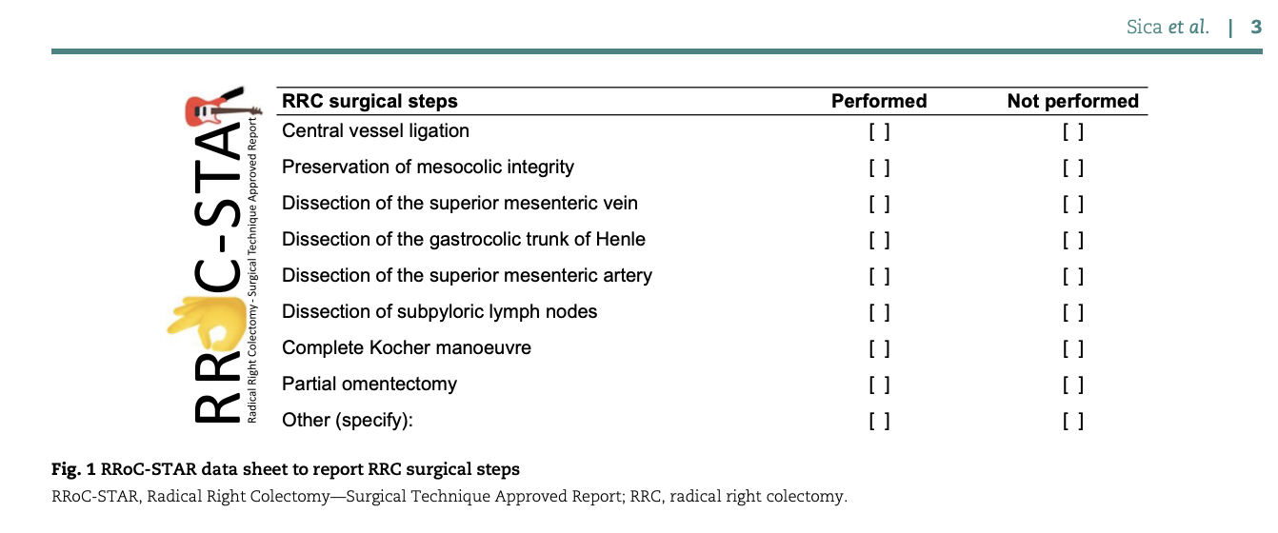
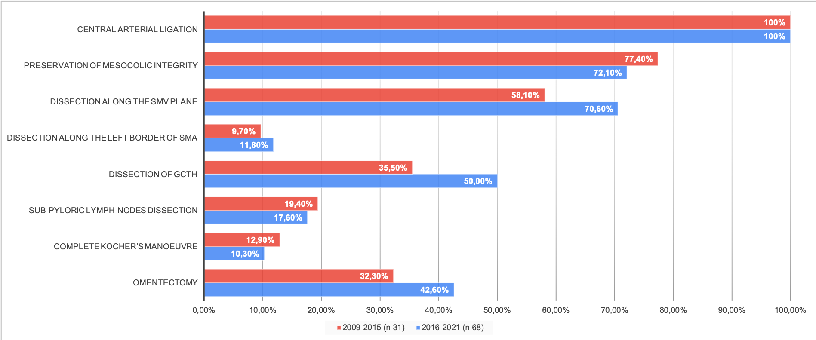

Slide 11
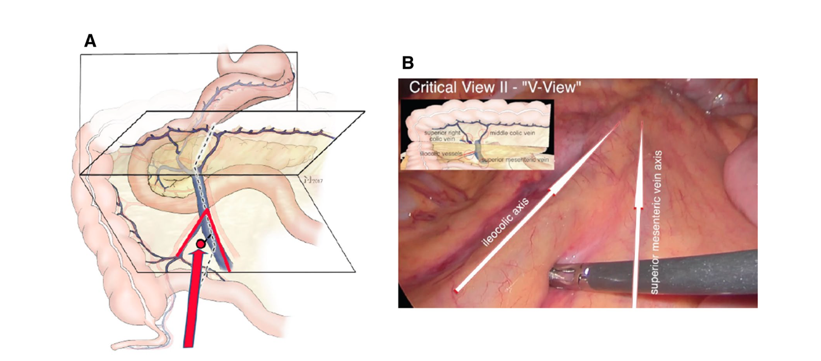
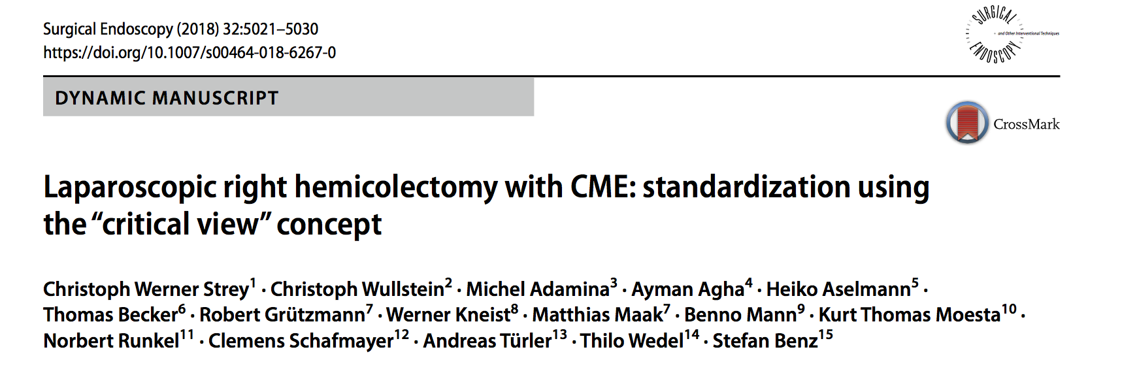
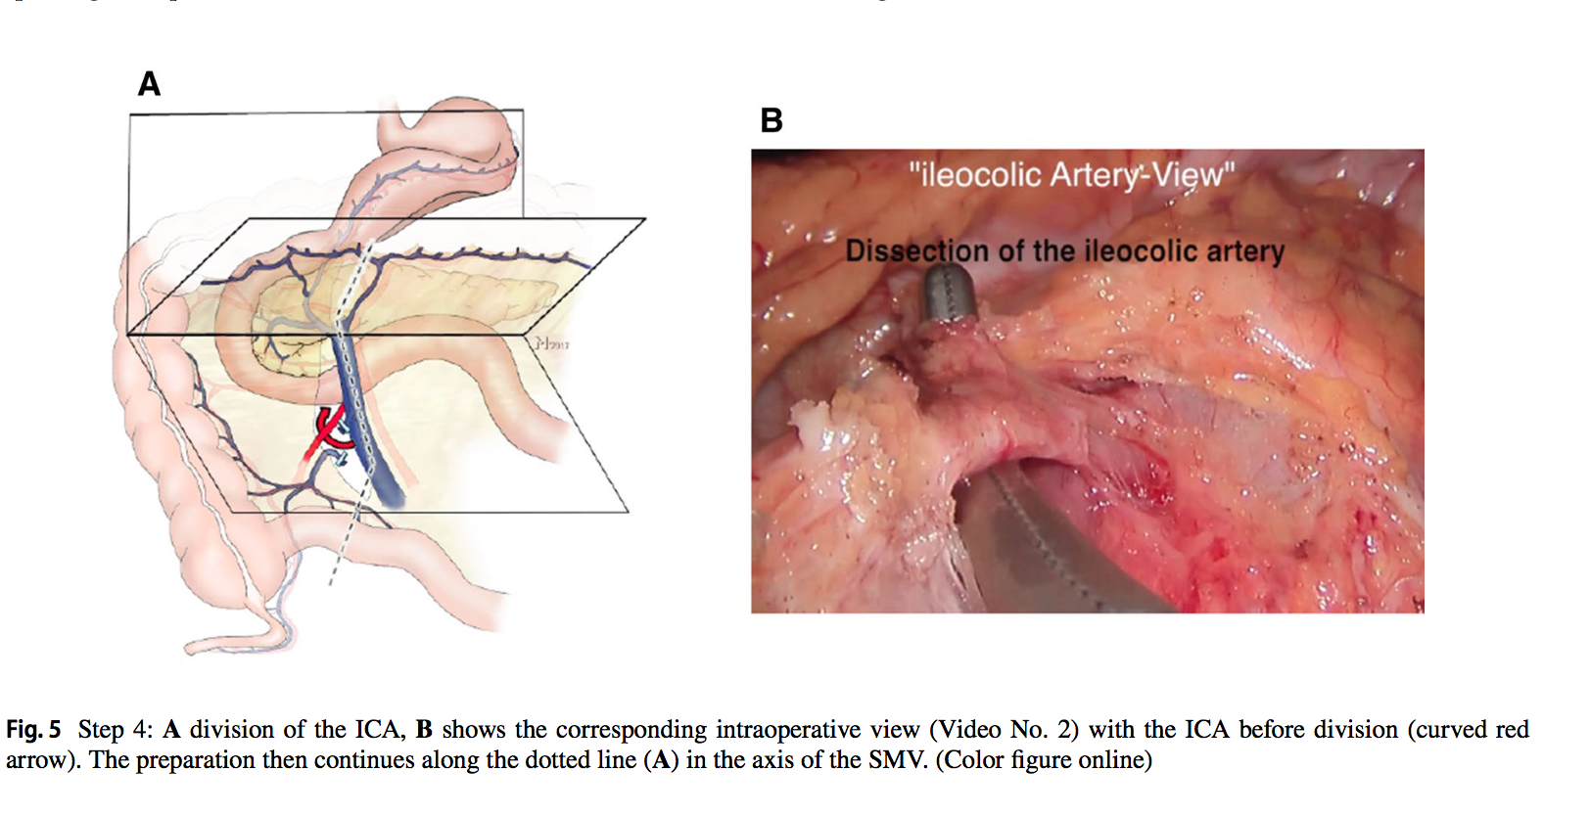
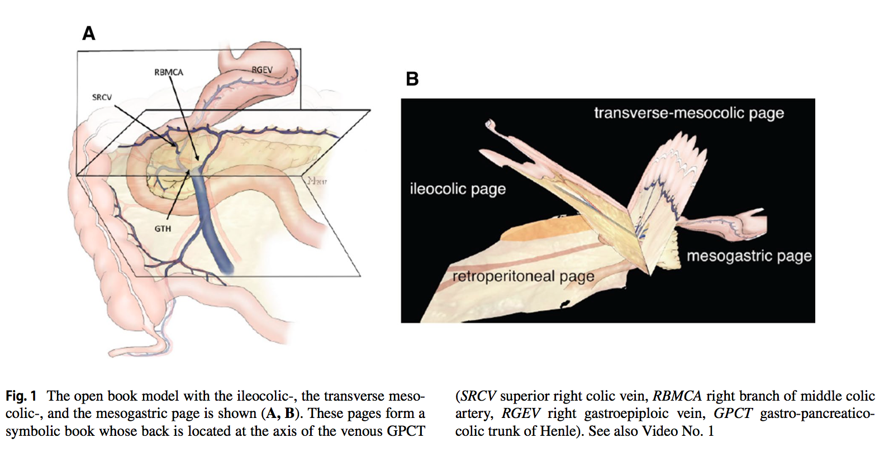

Slide 12
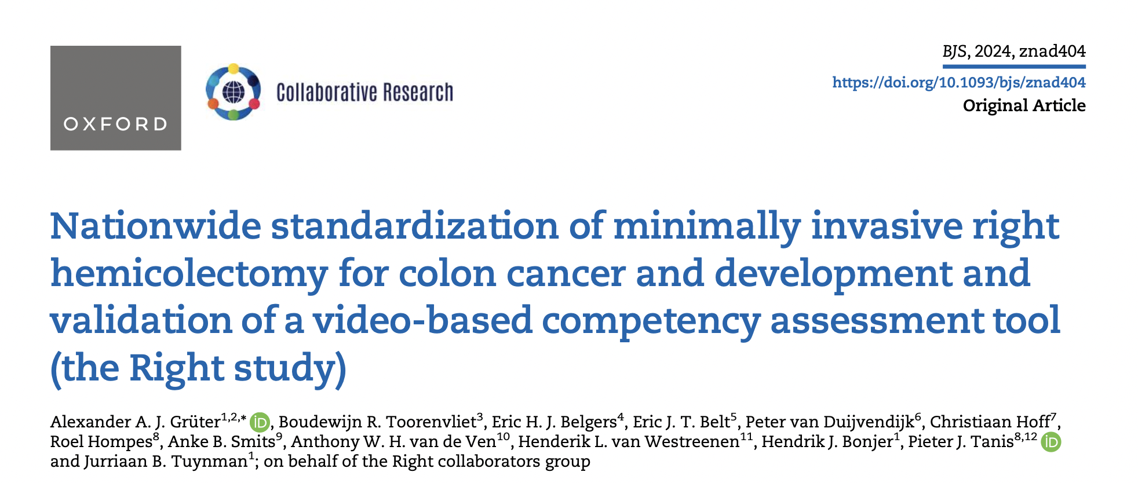

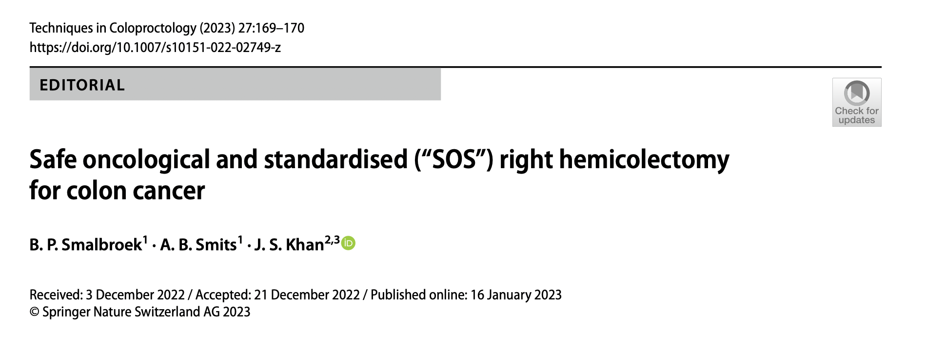
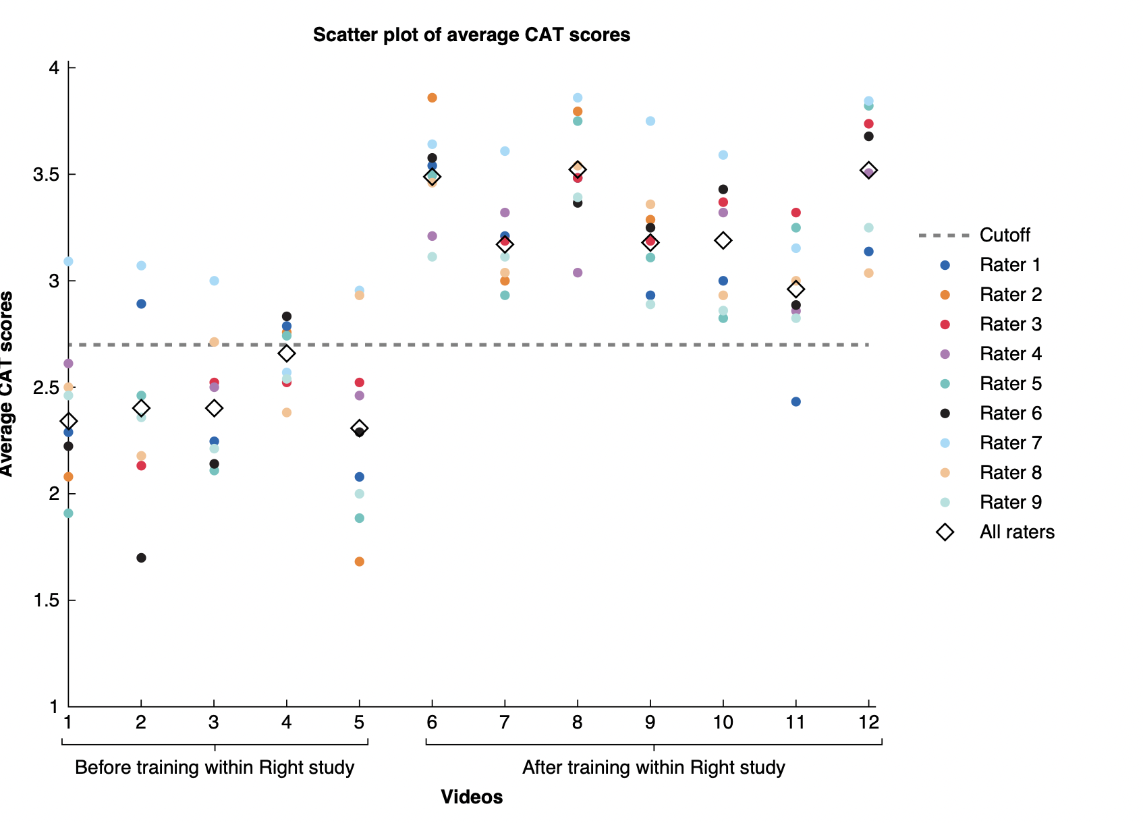
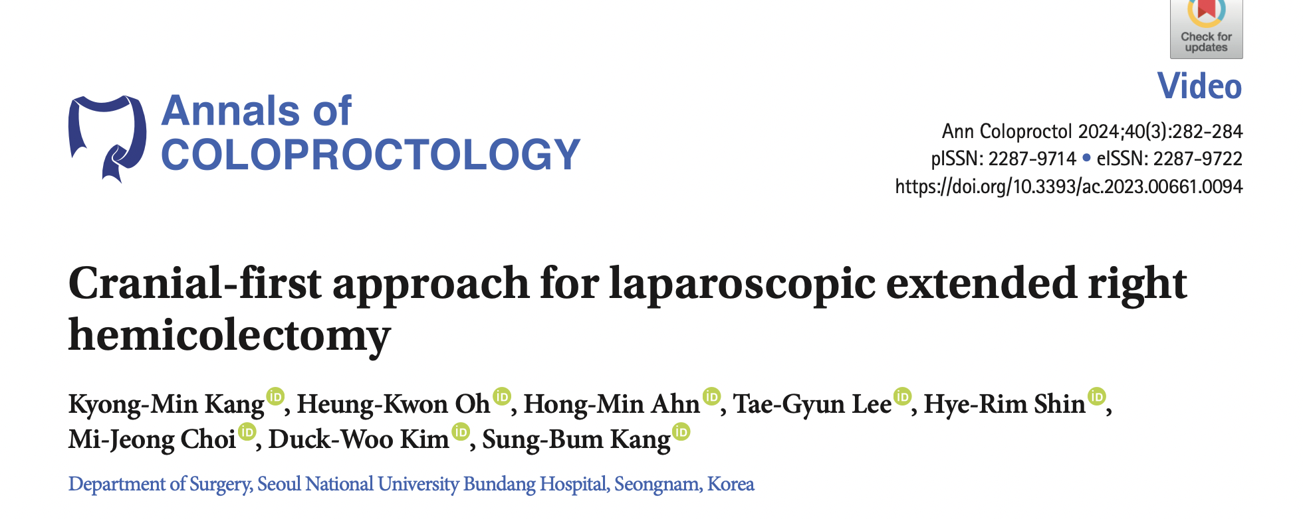
Training and Standardization
- Requires anatomical expertise and skill
- Training programs and mentorship needed
- Ongoing international standardization efforts

Slide 13
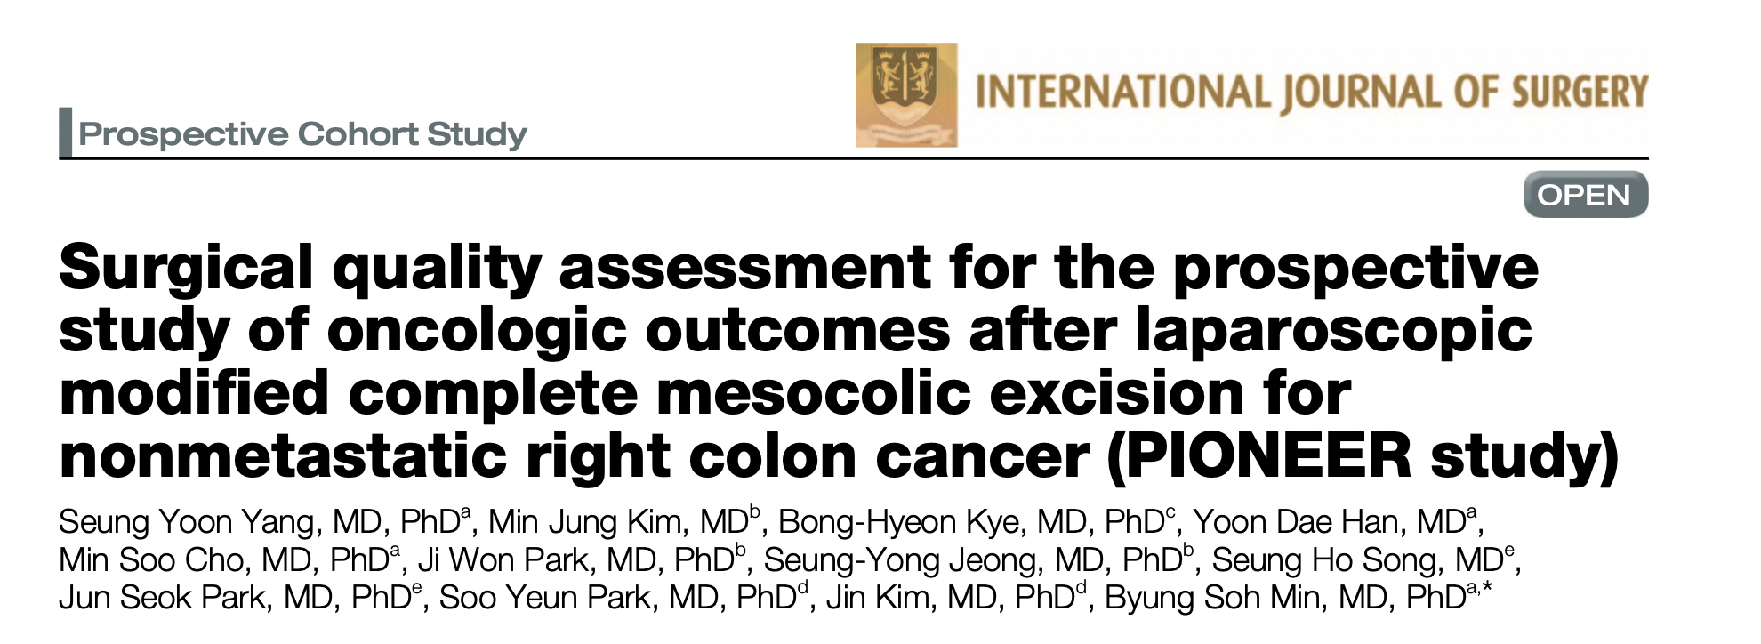
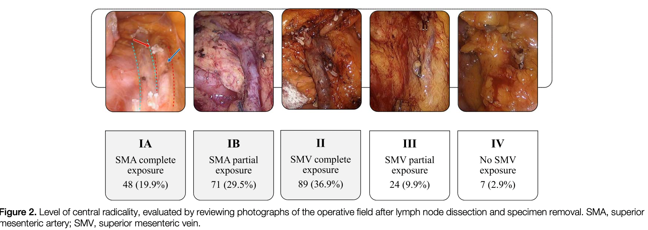

Slide 14
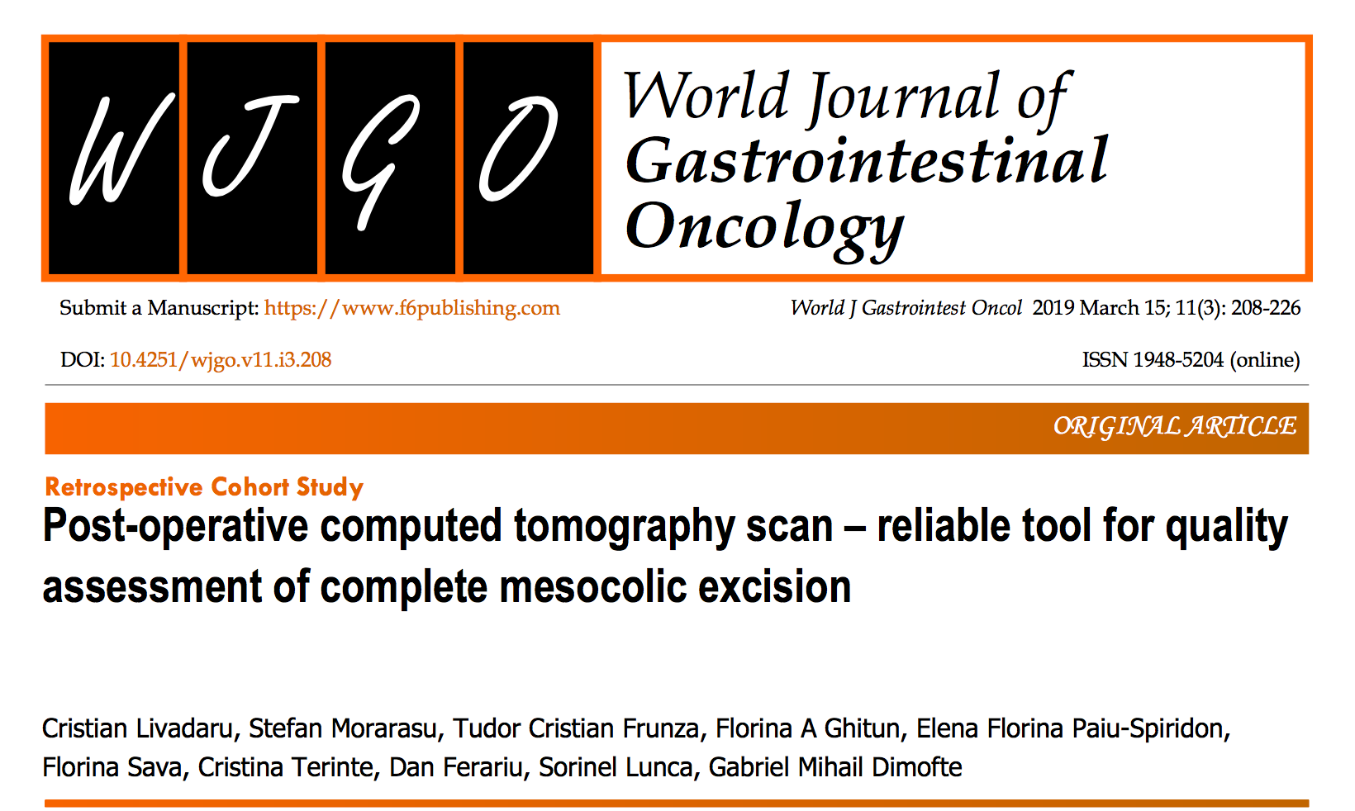
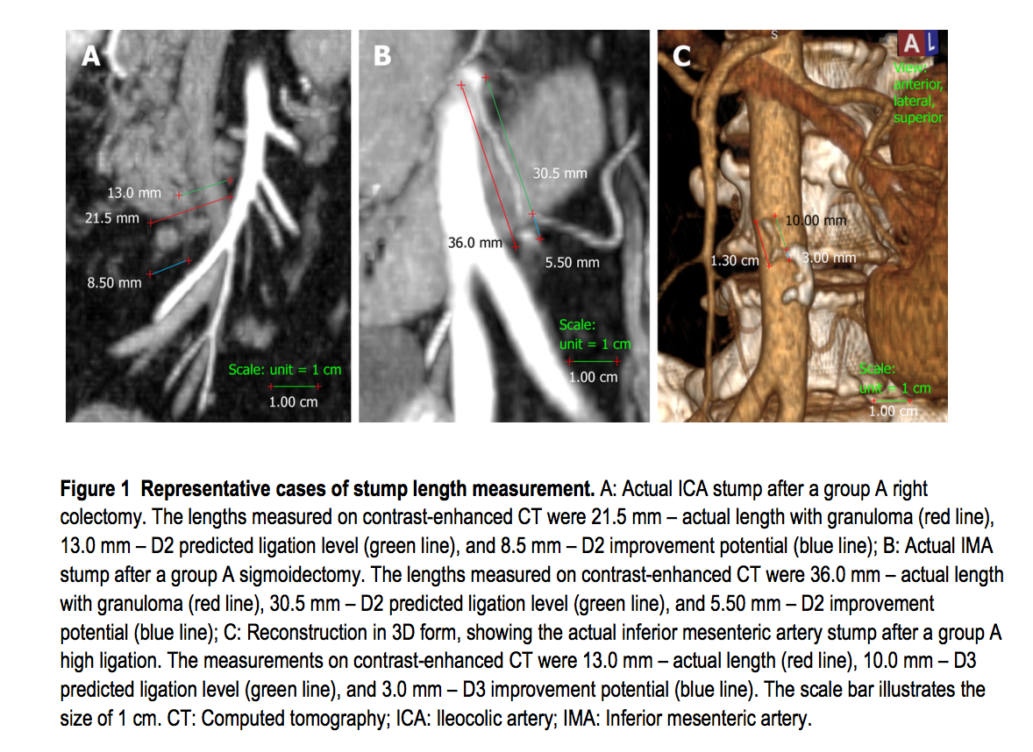
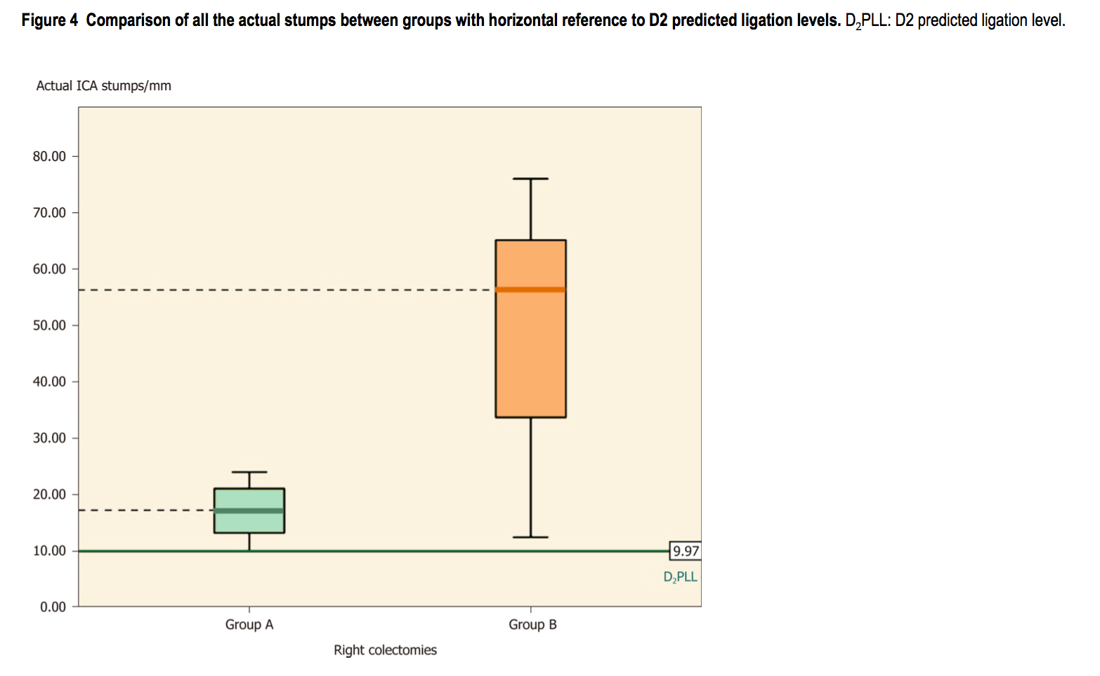

Slide 15
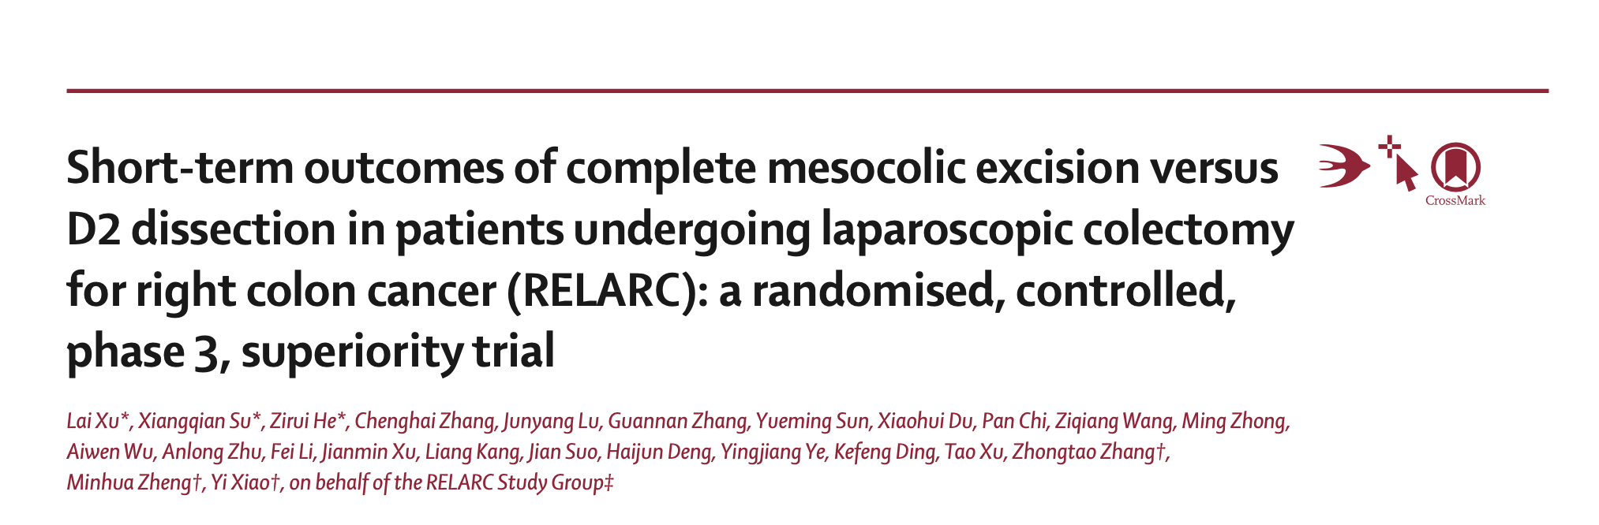
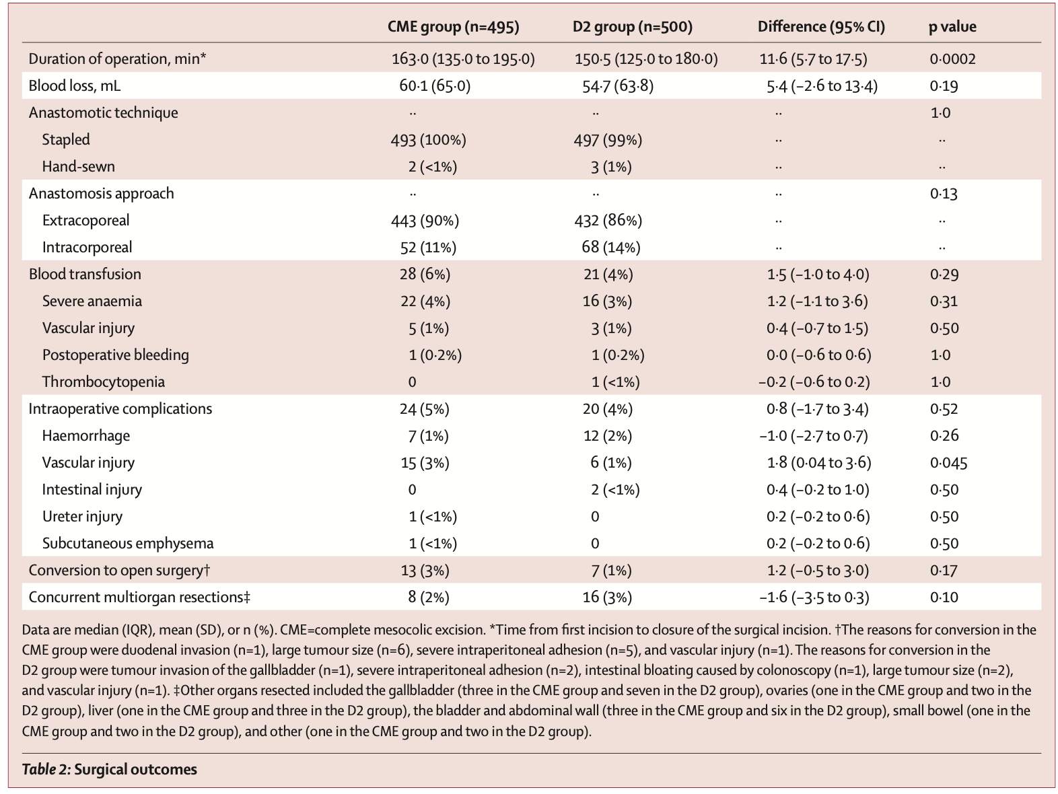
More Complications?
randomised, controlled, phase 3, superiority, trial
17 hospitals in 9 provinces of Chinaprimary endpoint 3-year disease-free survival
secondary outcomes
intraoperative surgical complications
postoperative complications within 30 days
mortality (death from any cause within 30 days of surgery)
central lymph node metastasis rate in the CME group

Slide 16
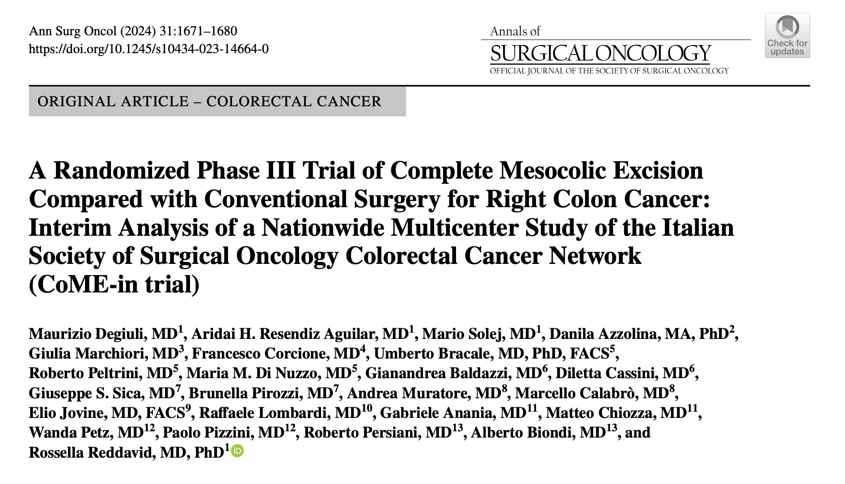
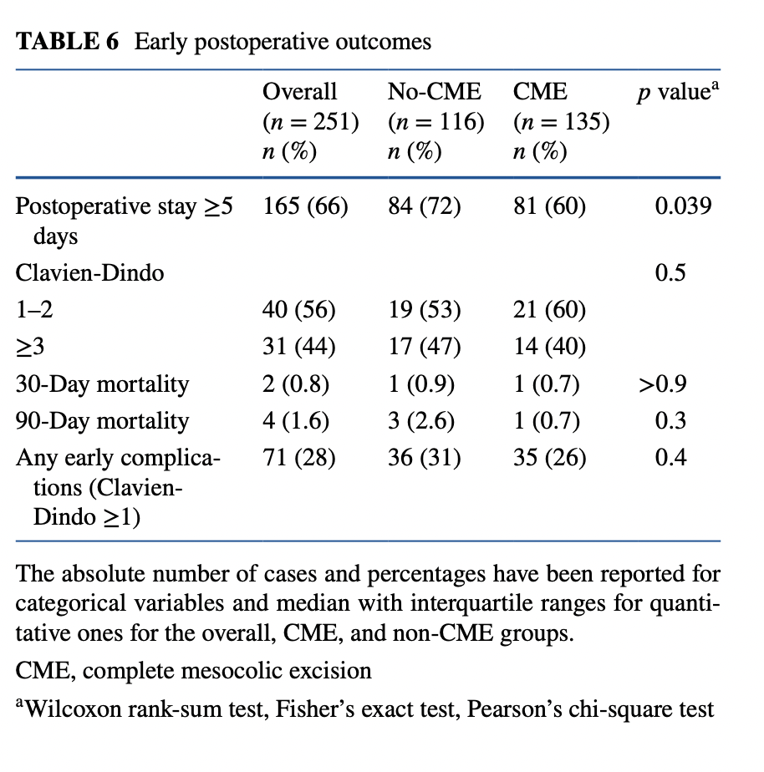
More Complications?
morbidity rates were acceptable and
similar to the conventional approach but
  A word of caution for:
  high BMI
  clinical N2
  T4 disease
  tumor size ≥6 cm

Slide 17
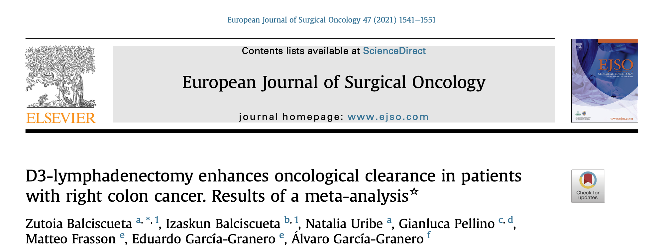
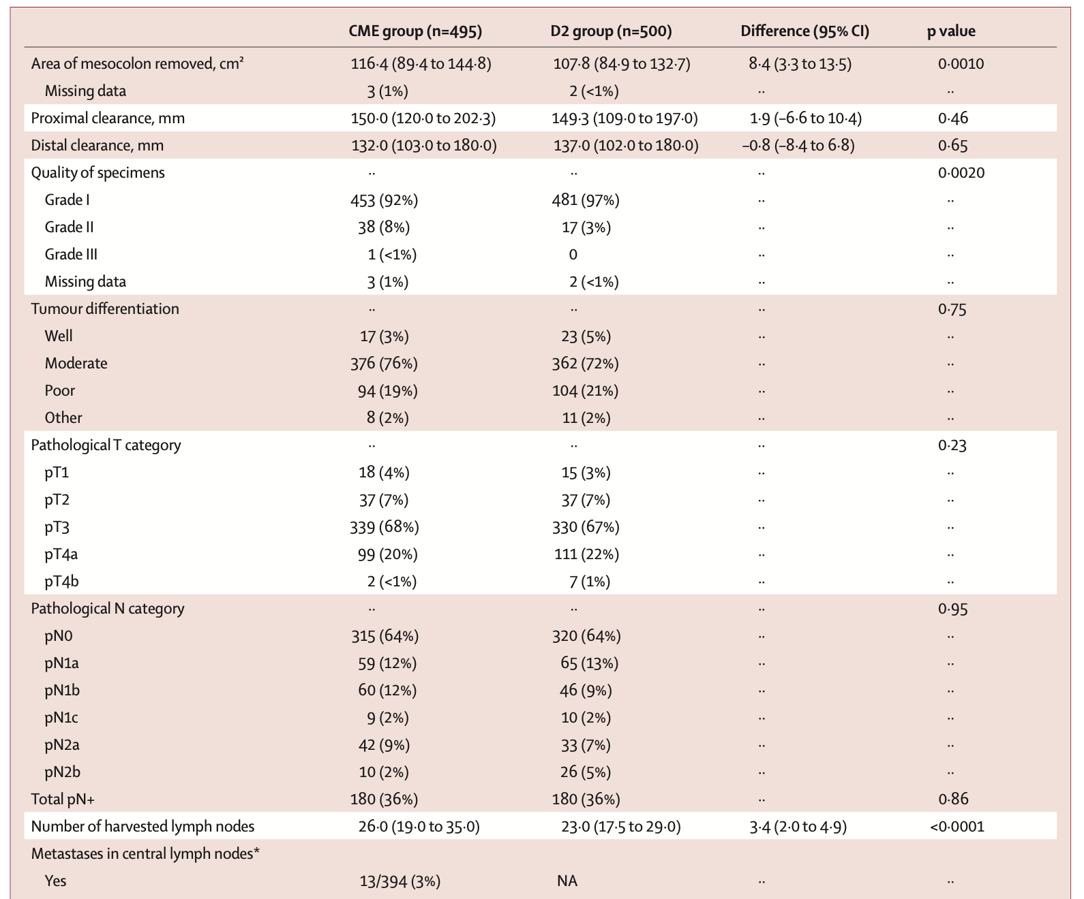
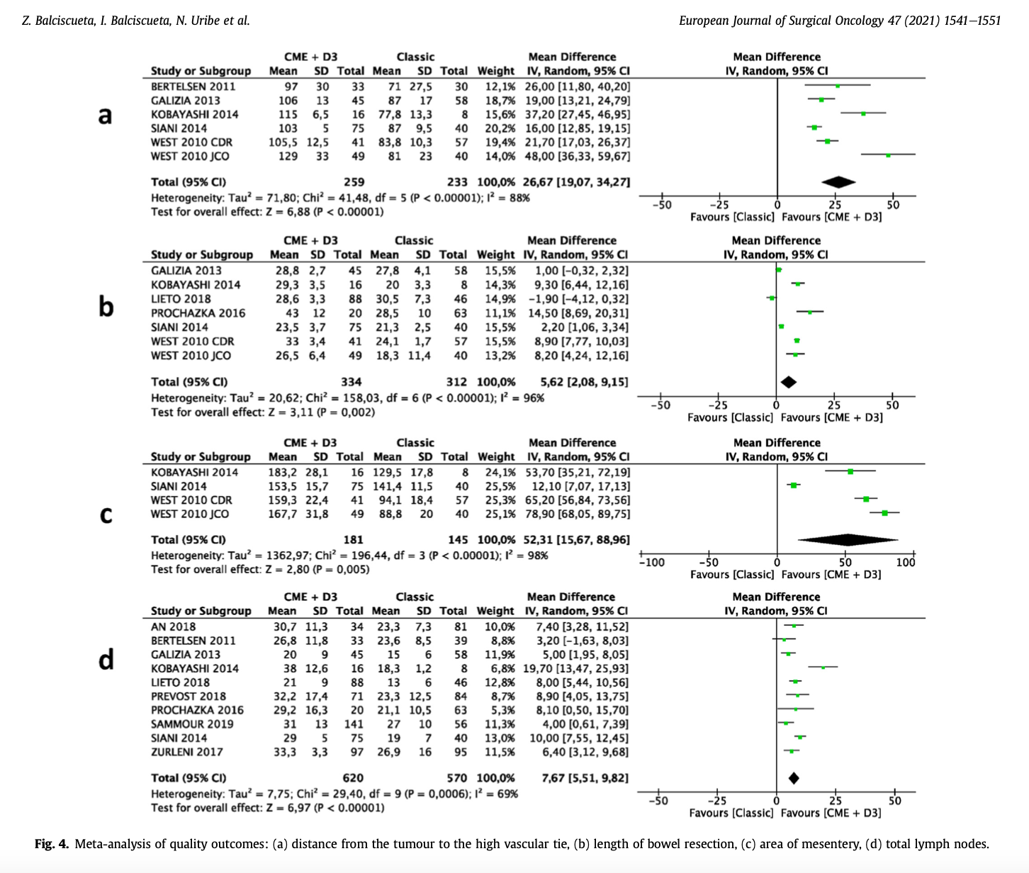
LN YELD
LN YELD

Slide 18
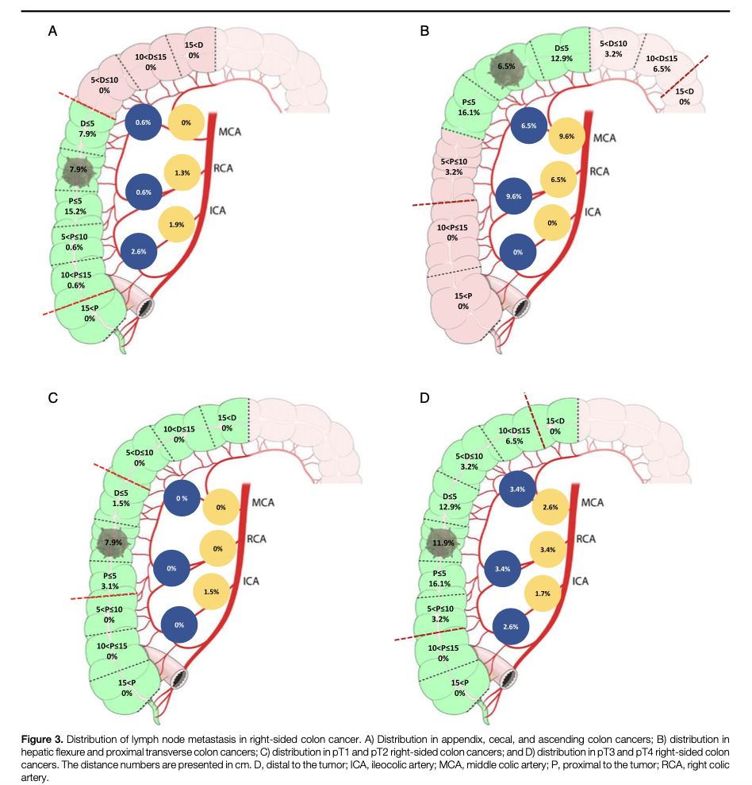
Does it fit for all?
No metastatic LNs were found at the root of the middle colic artery for tumors from the appendix to ascending colon.
no metastatic LNs at the root of the ileocolic artery for tumors located in the hepatic flexure colon and proximal transverse colon.

Slide 19
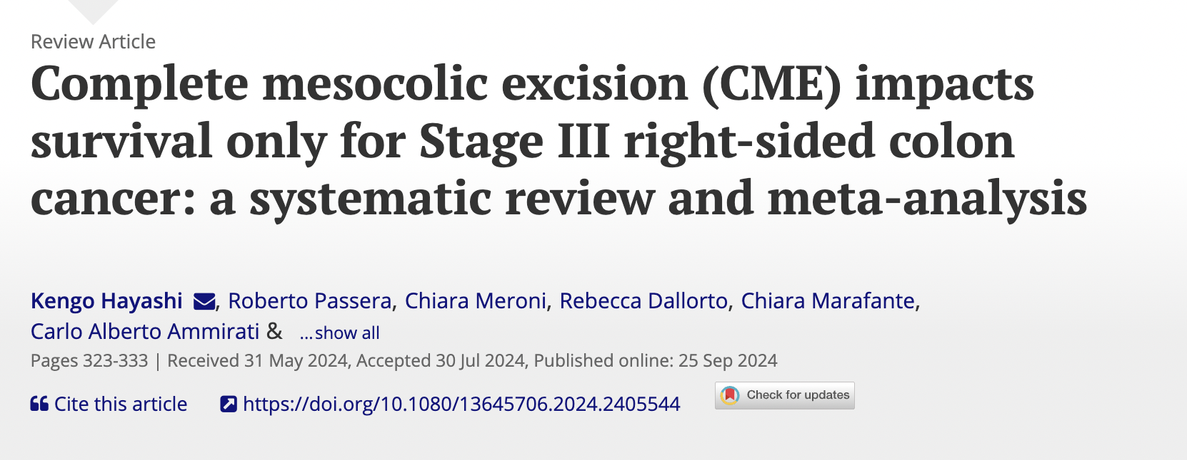
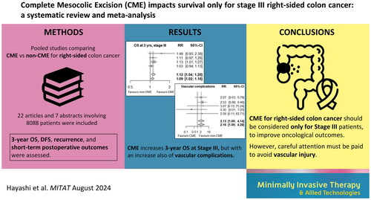

Does it fit for all?

Slide 20
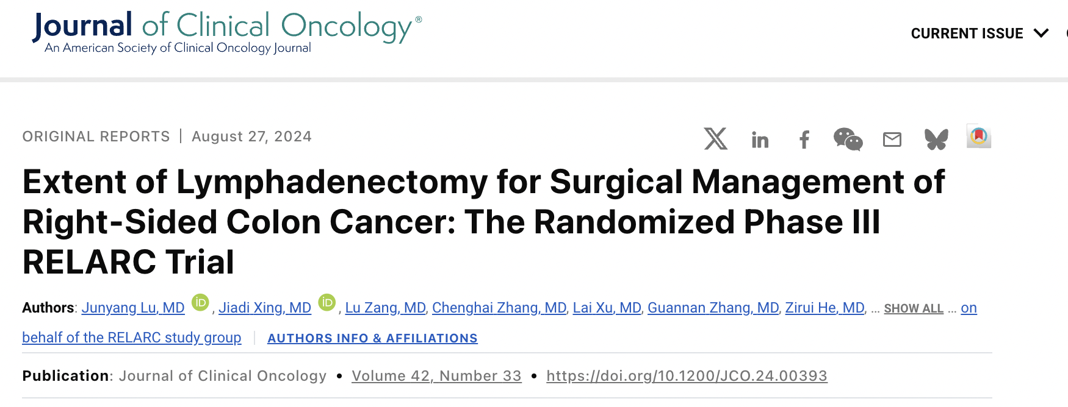

Does it fit for all?
1,072 patients
536 CME
536 patients D2 dissection
995 patients primary analysis
3-year DFS
86.1% CME group
81.9% D2 group
3-year OS
94.7% CME group
92.6% D2 group
No evidence of superior DFS outcome for CME compared with standard D2 lymph node dissection
Standard D2 dissection should be the routine procedure for these patients.
CME should only be considered in patients with obvious mesocolic lymph node involvement.

Slide 21
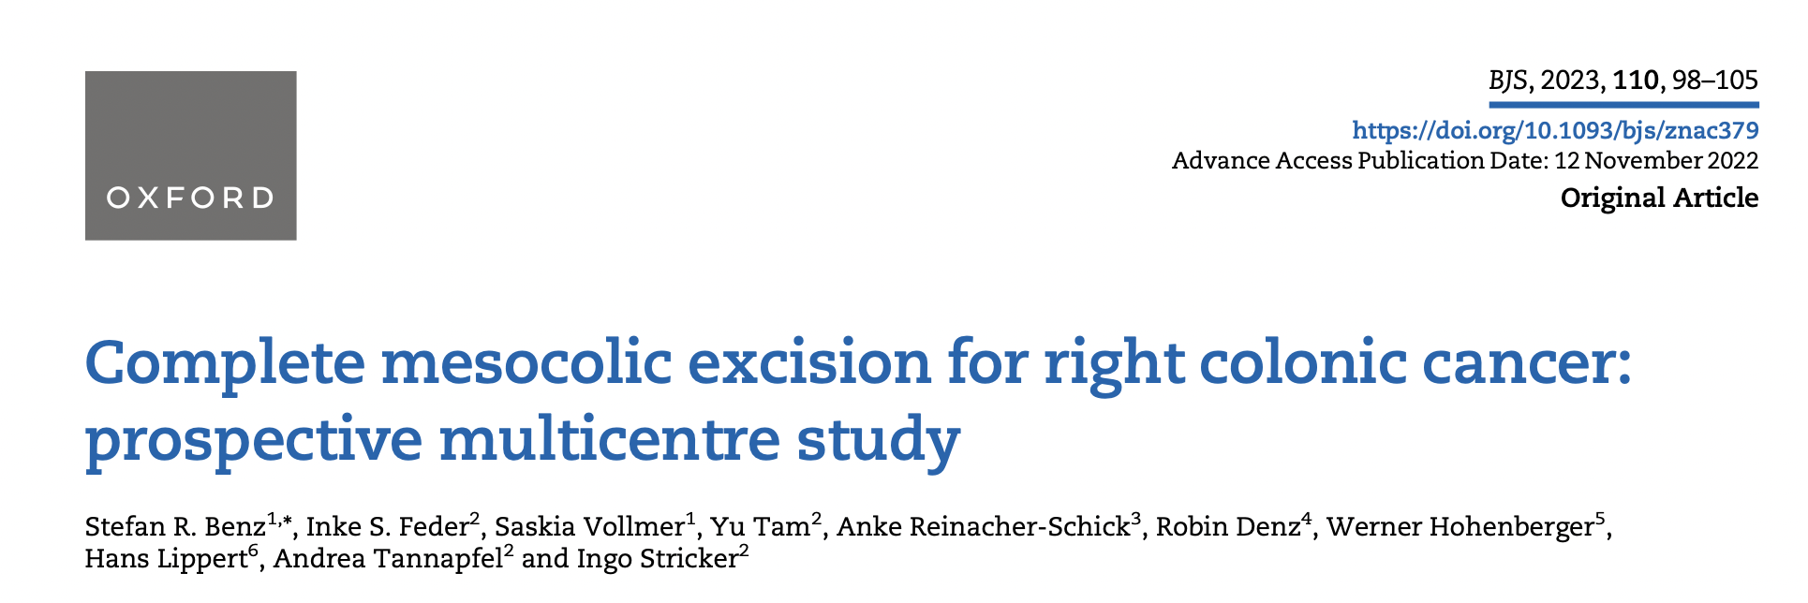
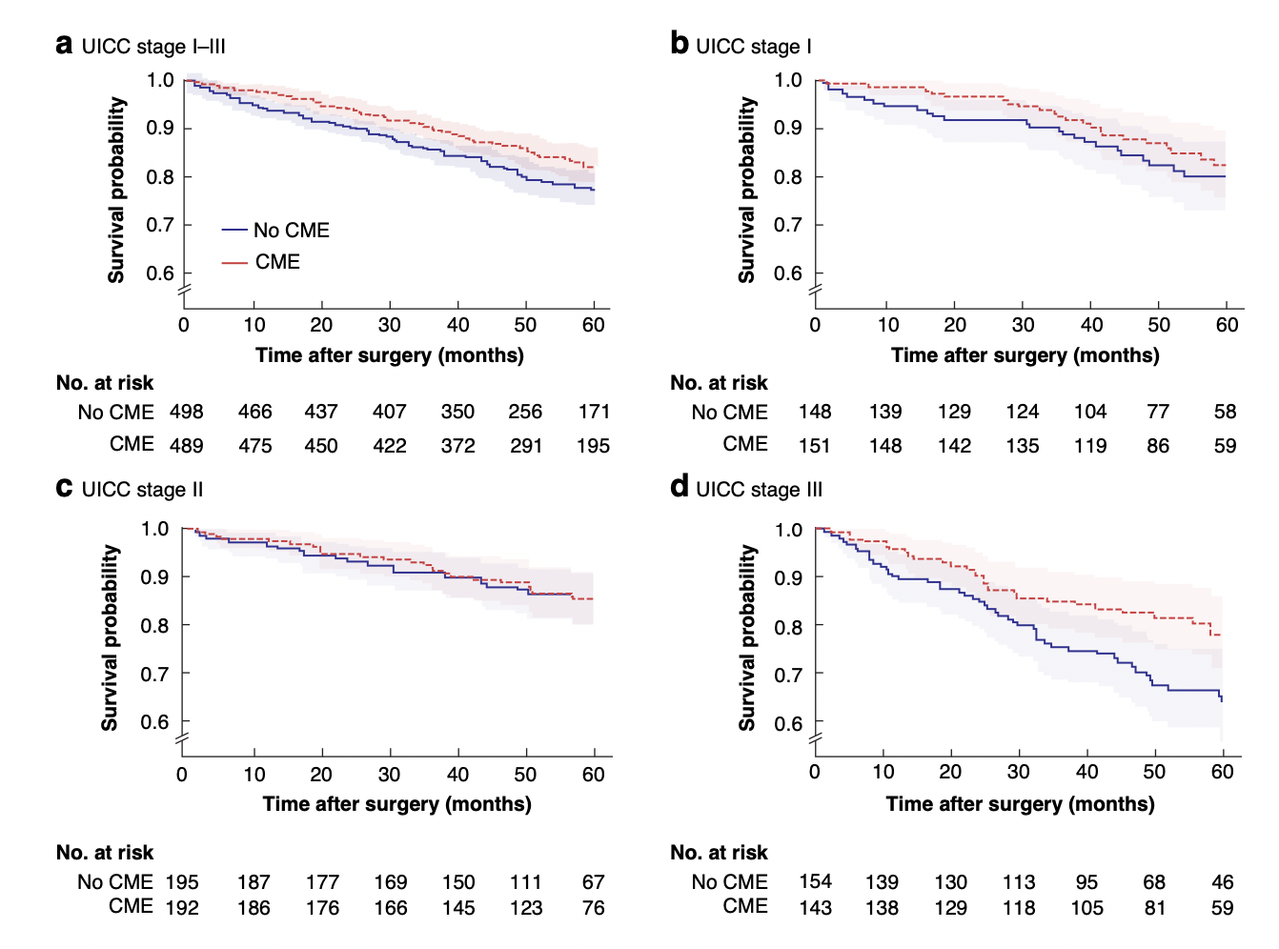

Does it fit for all?

Slide 22
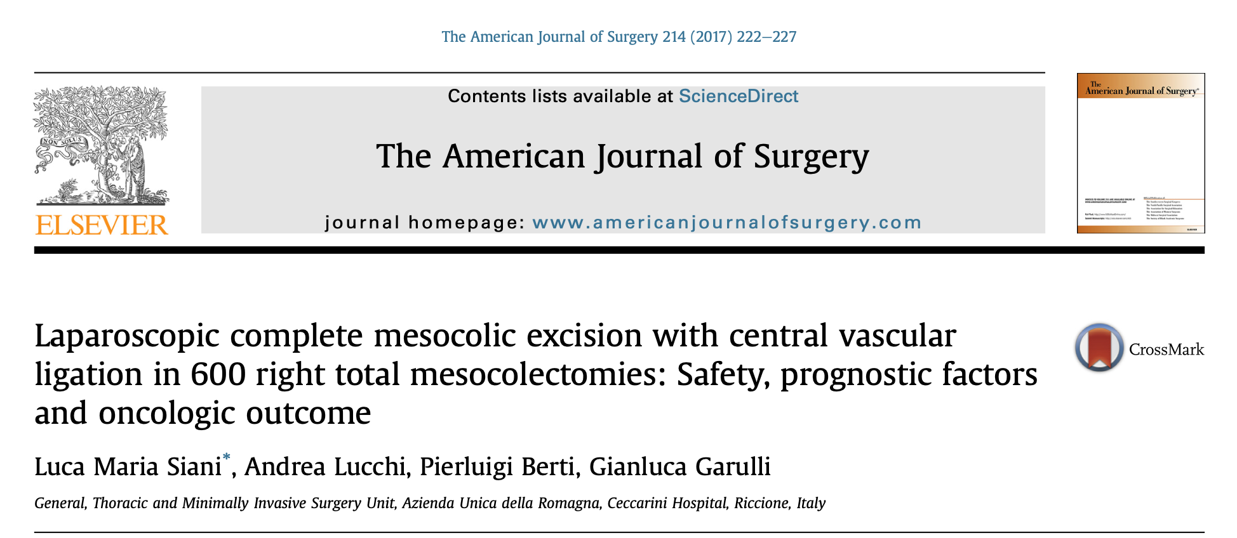
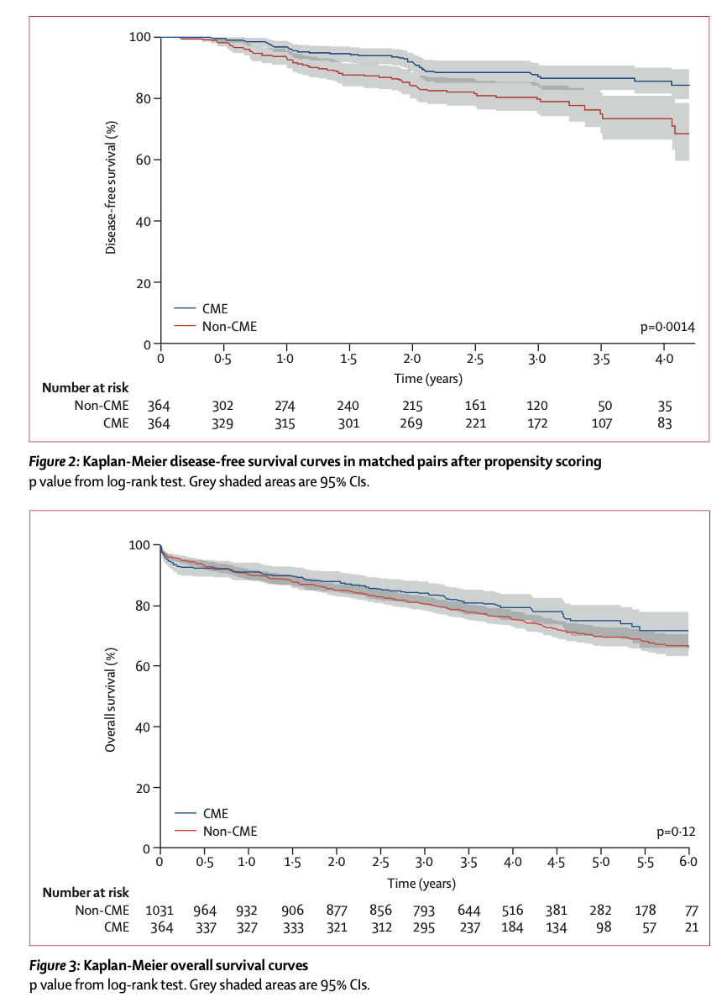

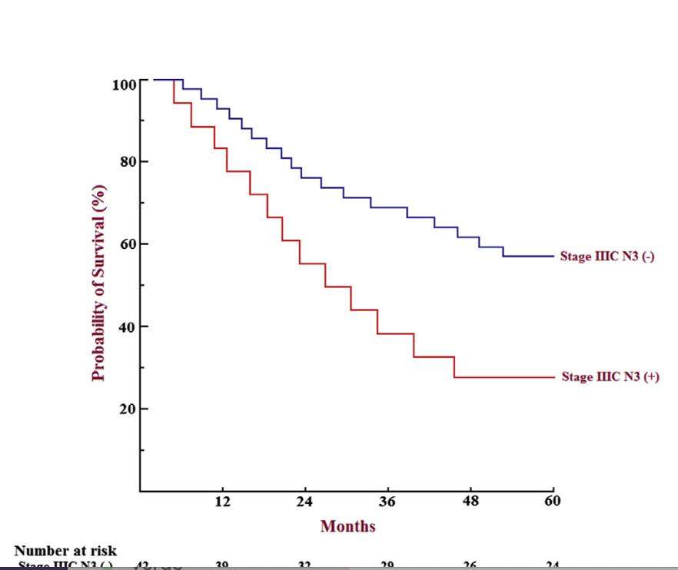
Does it fit for all?

Slide 23








Slide 24

conclusions: I am not convinced
Stage III seems favored in DFS and OS
Common lexicon, need to be standardized and verified
Difficult surgical procedure and CT angiography is mandatory
Training means that it should be done extensively to reach proficiency in those cases in which is needed
Robotics can help the training process and standardization

